Slide 1
DEM of a Granular-Jamming Soft Segment
Ursa

Slide 2
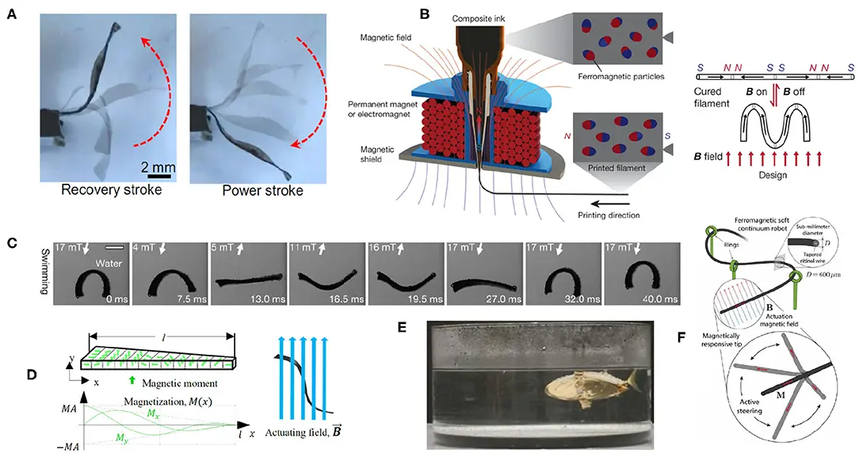
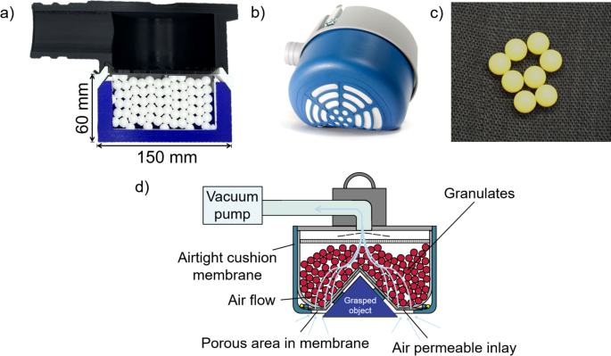
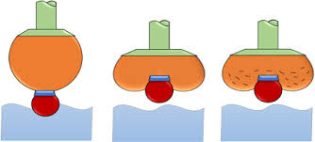
Granular jamming: if you pull a vacuum on a bag of grains, it suddenly becomes very stiff.
Unjammed: low stiffness for safe, dexterous motion and tip positioning.
Jammed: high stiffness for accurate shape holding and payload support.
The core is modeled as 21 particles in a line.
Neighboring particles are connected by linear springs, spring stiffness is about 50 kPa.
Around each core particle I place 6 granular beads, so in total over 100 beads representing the jamming sleeve.
All particles feel gravity, and the base node is clamped.
At the tip core node I apply a constant downward force.
vacuum = 0 → unjammed, soft contacts
vacuum = 1 → jammed, stiff contacts

Slide 3
